Slide 1


Improve the efﬁciency of your Flask app's frontend
Randy Duodu
FlaskCon 2021
Get Slides GitHub Repo
@iam_randyduodu
Notes:
Today we’ll be talking about the frontend of a Flask app and how we can improve its performance.
I’ll announce any updates to the slides or other resources on twitter so make sure you follow my account.

Slide 2

Who am I?
My name is Randy Duodu and I am from Ghana.
I am a Python developer with hands-on and applicable experience in developing web apps for the past 2 years with emphasis on back-end development.
Also, I write about my opinions and knowledge about tech related issues on my blog https://isolveit.hashnode.dev/

Slide 3
Overview
Objectives
Context
Types of website
The 2 sides of a dynamic website (front and back ends)
How a poor frontend can affect the performance of a website
Improving website’s frontend (Hands on)
Question & Answers
Further improvements
Conclusion
Notes:
Along those lines, we’ll work on an understanding of the topic and how it can be effected.
Let me be clear before we start…
I’m not going to be perfect and I don't have time to go into every detail.
If I have time at the end then I'll take questions.

Slide 4
Objectives

Slide 5

Objectives
The project (a portfolio site) used as a demo is a beginner friendly Flask app with no advanced configurations.
Objectives
Check the performance score of a page on the website for both mobile and desktop devices using a tool called LightHouse.
Identify and implement some suggestions that can help improve page load time.
Identifying
Run a LightHouse performance report
Try implementing most of the suggestions given by the report.
Resolving
Minifying HTML, CSS and JS files
Using Flask-Compress (a Flask extension) to compress text. NB: Be careful with compressing
Tackle problems with images like serving images in next-gen formats and lazy loading images
Implementing a cache policy on static assets like CSS, JS, font, and image files

Slide 6
Context

Slide 7
Types of website
A website, or individual web page, can be static or dynamic.
A static website or static web page contains information that doesn't change automatically. It remains the same, or static, for every viewer of the site.
A dynamic website or dynamic web page contains information that changes, depending on the viewer, the time of the day, the time zone, the viewer's native language, and other factors.
Notes:
- A dynamic website can contain client-side scripting or server-side scripting to generate the changing content or a combination of both scripting types.
- These sites also include HTML programming for the basic structure.
- The client-side or server-side scripting takes care of the will power of the site.

Slide 8
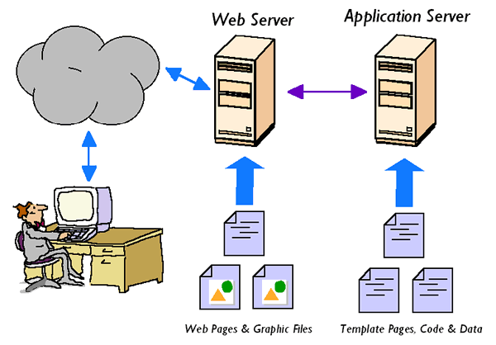
The 2 sides of a dynamic website (front and back ends)
Notes:
User opens a browser on their computer and searches for flaskcon.com
Browser makes a request on behalf of the user to the server
The server assesses the request and responds to the browser if the request is valid.
Often the response from the server contains files.
The browser downloads these files and then processes it into the intended interface developed by the web developer so that the user can interact with the application.
The part of a web application or website with which the user interacts directly is known as the Frontend.

Slide 9
How a poor frontend can affect the performance of a website
Although the frontend and backend of a website are distinct, both frontend and backend must be developed to perform well in order for a website to have fast load and render times.
Remember, the backend of your website based on metrics will be efficient but an inefficient frontend will still make your website experience slow load and render times.
Notes:
Load time is the time it takes for a webpage to download into a user’s browser.
Render time is the time it takes to fully process the page’s content, so that visitors can interact with the end-result.
In other words, load time is how long it takes for a page to become visible, and render time is how long it takes for a page to become usable.

Slide 10

Improving website’s frontend (Hands on)
Let the fingers dance on the keyboard

Slide 11
Questions & Answers or No Answers

Slide 12
Further Improvements
Using a CDN (Content Delivery Network)
Using a front-end framework of your choice
Using a reverse proxy like Nginx to intercept communication between client and server
Implementing http2 or http3 on your server
Readings
Visit Webdev to read more about improving a website’s frontend performance

Slide 13

What’s Next? (Conclusion)
Key Take-aways
The frontend is what the user interacts with so ensure it works well but remember both the frontend and backend make a great website user experience.
Apply the lessons learnt to some of your websites to widen your understanding.

Slide 14
Thank you 🤗🙏

